Slide 1

SLIDES
Title
Our Team
Content
Introduction
Background
Object Detection
Perturbation: Goal
Perturbation: Targeted vs Untargeted
Research Question
Research Goal
Motivation
Method
Steps
Pipeline
Loss
Parameters
Experiments
Research Question (reiterate)
Data
Experimental setup
Results
Discussion
Effectiveness and limitations
Use case
Future Work
Thank You

Slide 2
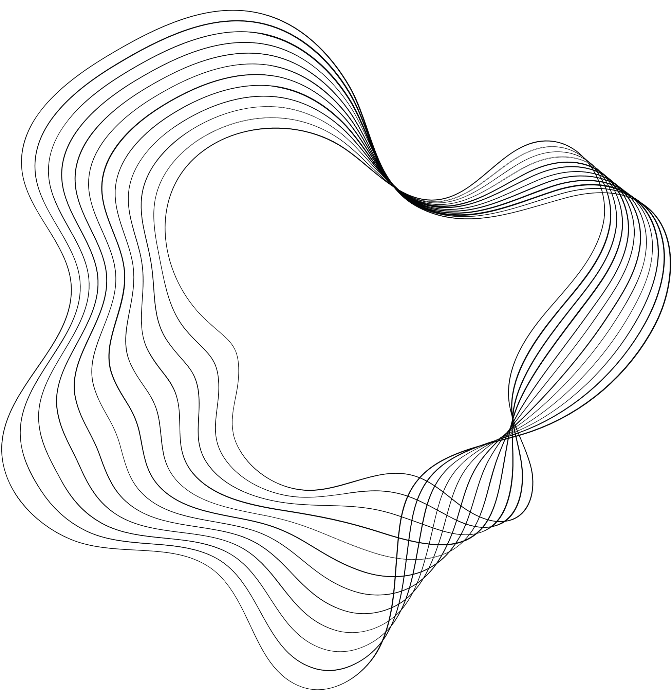


BEN GURION UNIVERSITY
EXCLUSIVE PERTURBATION
OFFENSIVE AI

Slide 3


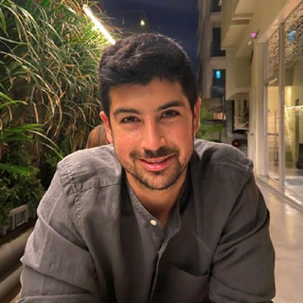
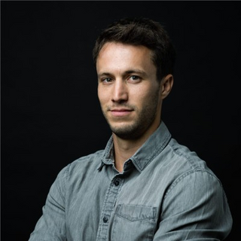

OUR TEAM
Idan Yankelev
Yarin Yerushalmi
Yonatan Amaru
Amit
Baras

Slide 4
INTRODUCTION

Slide 5
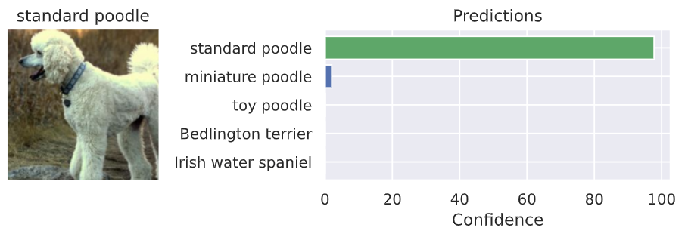
BACKGROUND
Object Classification
Computer vision technique for classifying instances of objects in images or videos.

Slide 6
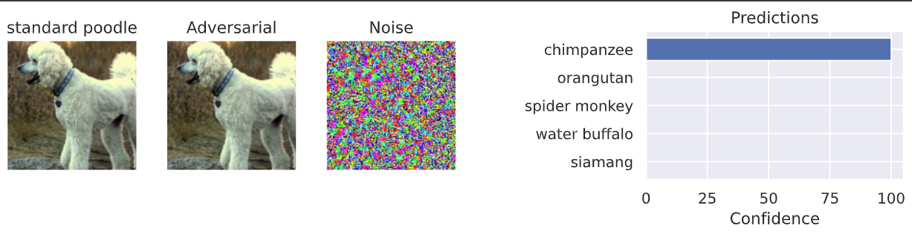
BACKGROUND
Adversarial Perturbation Attack
Intentionally adding subtle noise to the input data to manipulate the model.

Slide 7
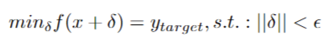
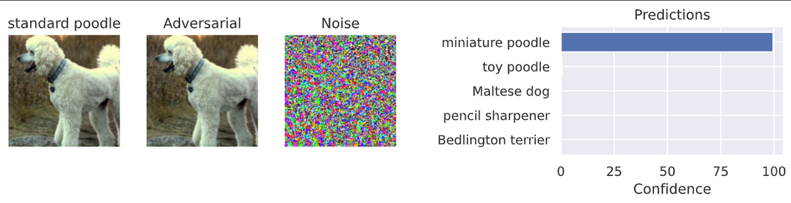
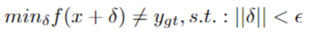
BACKGROUND
Adversarial Attack Settings
In a targeted setting, the attack aims to manipulate the model to predict a specific target.
In an untargeted setting, the attack aims to harm the overall model’s performance.

Slide 8
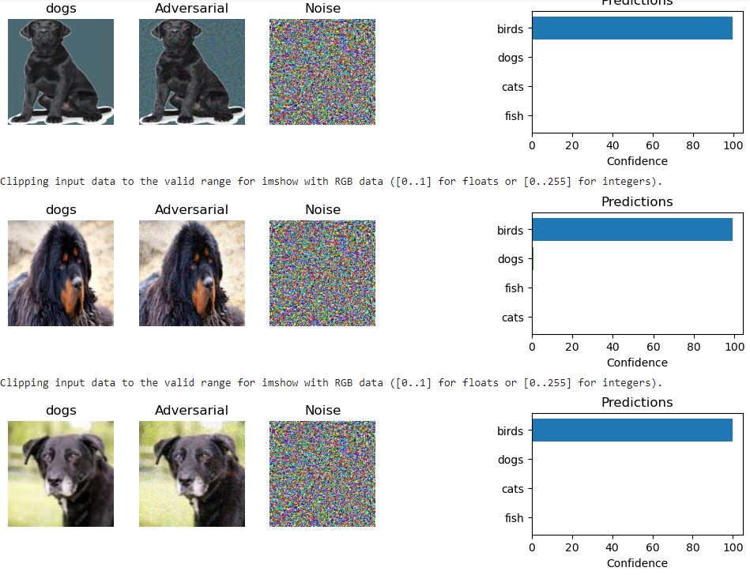
BACKGROUND
Universal Adversarial Perturbation Attack
An adversarial perturbation that affects a set of images.

Slide 9
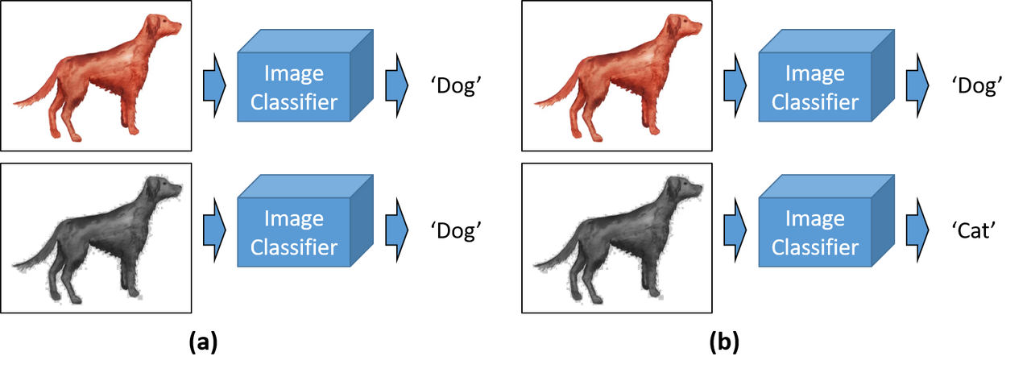
RESEARCH QUESTION
Can an adversarial perturbation affect specific images within a class without affecting the other images in the class?

Slide 10
RESEARCH GOALS
Universal adversarial perturbation such that:
Affects a specific set of images within one class.
Does not affect other images from that class.

Slide 11



MOTIVATION
נראלי צריך להוסיף עוד
Exclusive Perturbation
Escape detection
Universal yet exclusive

Slide 12
METHOD

Slide 13

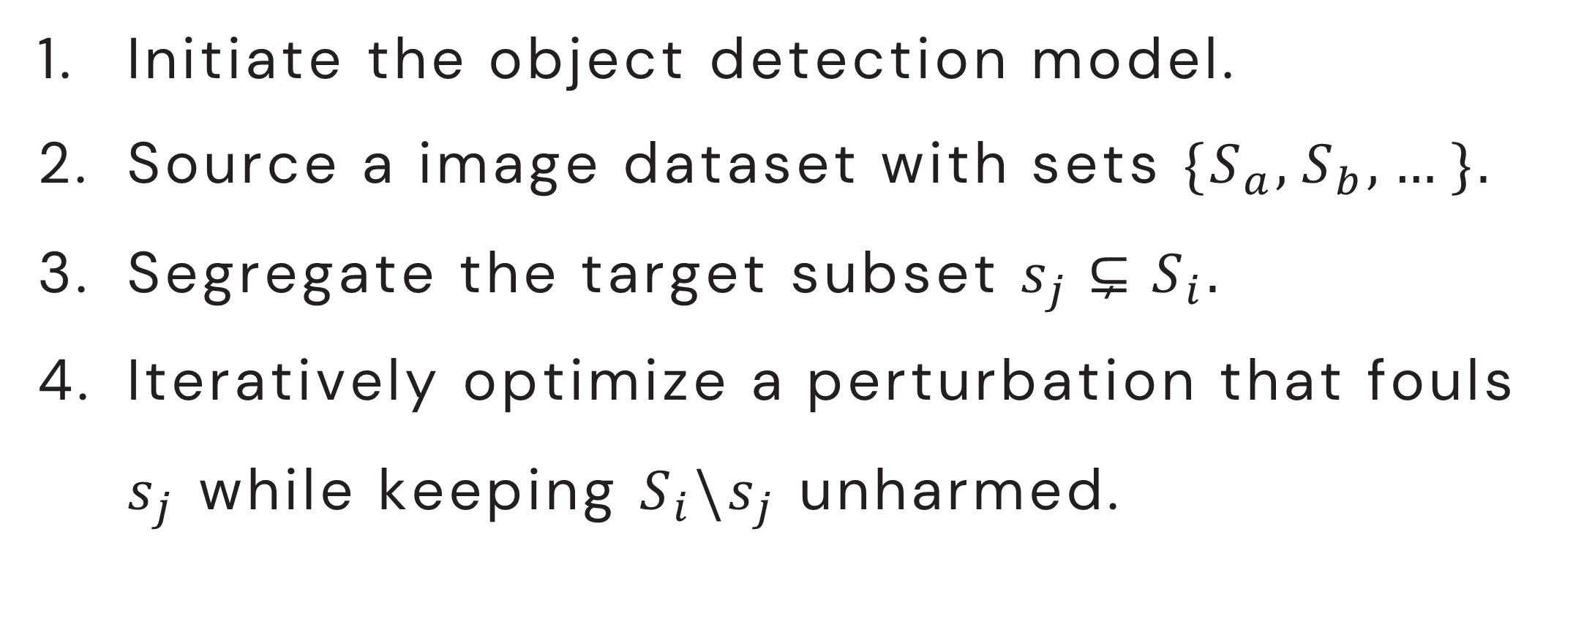
METHOD
Initiate the object detection model.
Source a image dataset with sets ${\{S}_{a}, S_{b}, …\}.$
Segregate the target subset $s_{j}⊊S_{i}.$
Iteratively optimize a perturbation that fouls $s_{j}$ while keeping $S_{i}\backslash s_{j}$ unharmed.
$$∀ x_{i}∈ s_{j}: f\left(x_{i}+δ\right)= y_{\left\{target\right\}}≠c,$$
$∀ x_{j}∈ S∖ s_{j}: f(x_{j}+δ) = c$,
$$s.t.: \left|\left|δ\right|\right|<ε$$

Slide 14


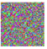


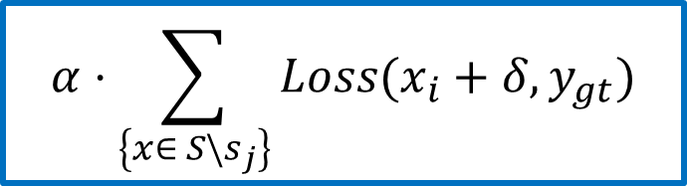
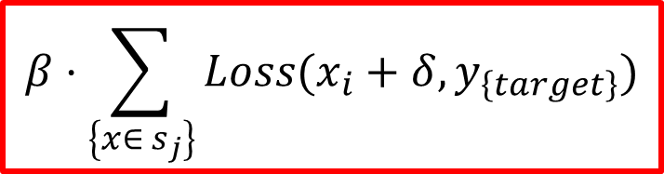
METHOD - Targeted
$$β⋅\sum_{\left\{x∈ s_{j}\right\}}{Loss(x_{i}+δ, y_{\left\{target\right\}})}$$
$$α⋅\sum_{\left\{x∈ {S\backslash s}_{j}\right\}}{Loss(x_{i}+δ, y_{gt})}$$

Slide 15

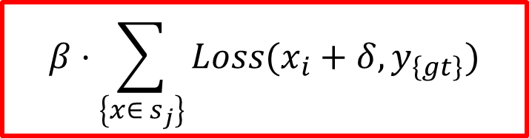
METHOD - Untargeted
$$β⋅\sum_{\left\{x∈ s_{j}\right\}}{Loss(x_{i}+δ, y_{\left\{gt\right\}})}$$
$$α⋅\sum_{\left\{x∈ {S\backslash s}_{j}\right\}}{Loss(x_{i}+δ, y_{gt})}$$

Slide 16





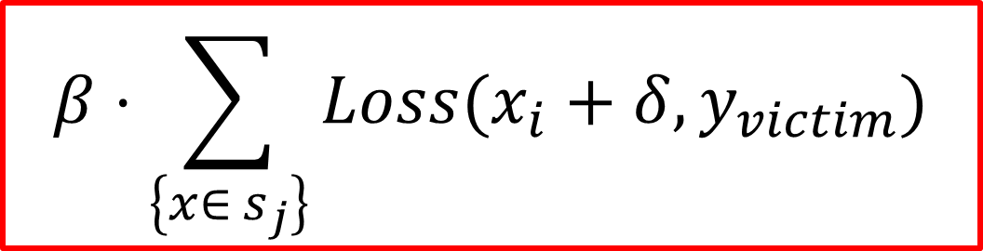
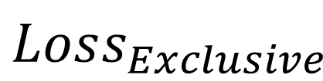
METHOD
Targeted vs. Untargeted
$$α⋅\sum_{\left\{x∈ {S\backslash s}_{j}\right\}}{Loss(x_{i}+δ, y_{keep})}$$
$$β⋅\sum_{\left\{x∈ s_{j}\right\}}{Loss(x_{i}+δ, y_{victim})}$$
$$Loss_{Exclusive}$$
Ground Truth
Ground Truth vs. Targeted

Slide 17
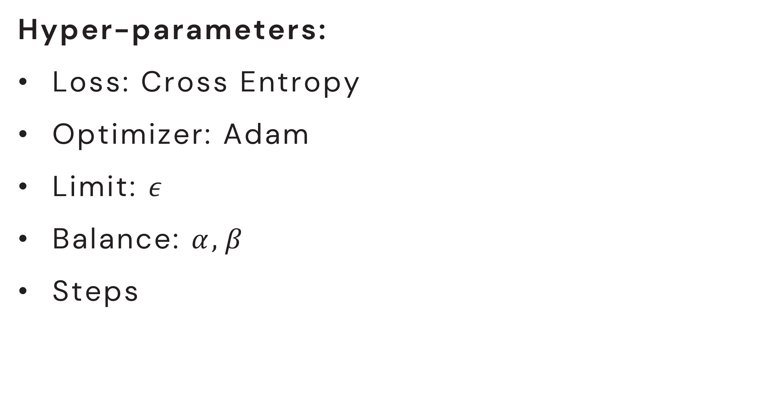
METHOD
Hyper-parameters:
Loss: Cross Entropy
Optimizer: Adam
Limit: $ε$
Balance: $α, β$
Steps

Slide 18
EXPERIMENTS

Slide 19
בעקרון עשינו על כל החיות, האם צריך לשנות את התיאור?
EXPERIMENT
Can a perturbation harm the classification of black dogs with minimal harm to other dogs and classes?

Slide 20
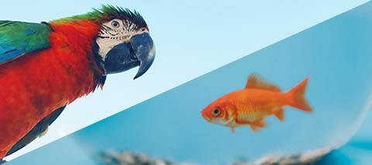
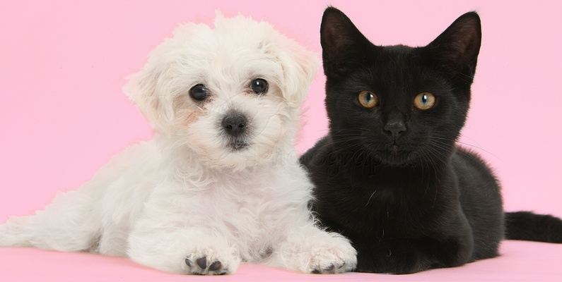
EXPERIMENT
DATA:
Dog images.
Cat images.
Fish images.
Bird images.
Each consists of around ~1200 images.

Slide 21
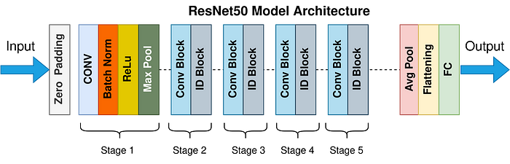
EXPERIMENT
Setup:
Resnet50.
Pretrained on ImageNet (14M+ Pictures!).
Finetuned to classify only 4 classes (dogs, cats, fish and birds).

Slide 22
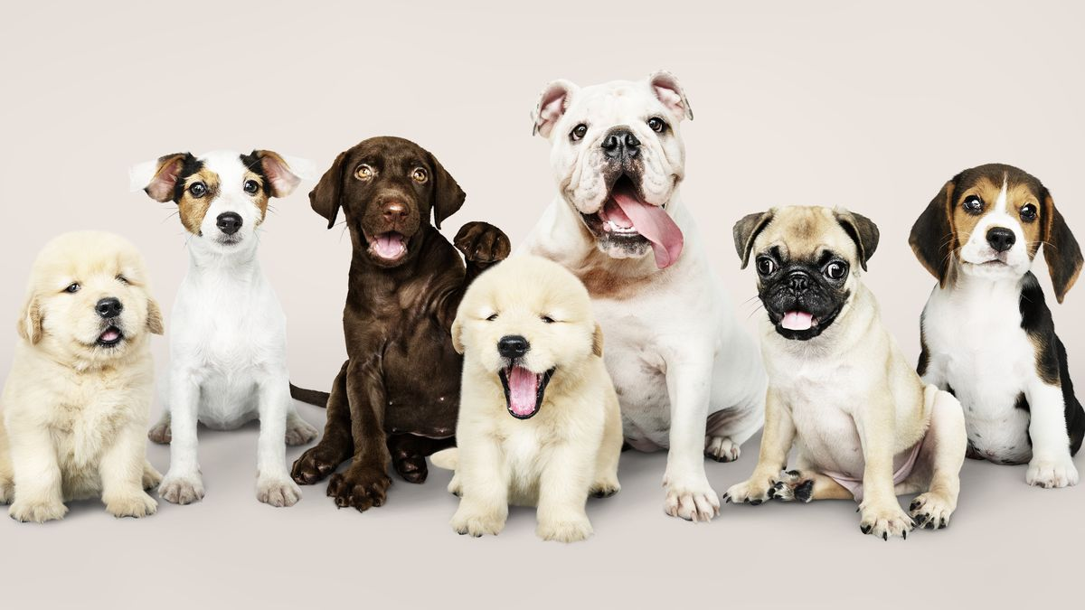
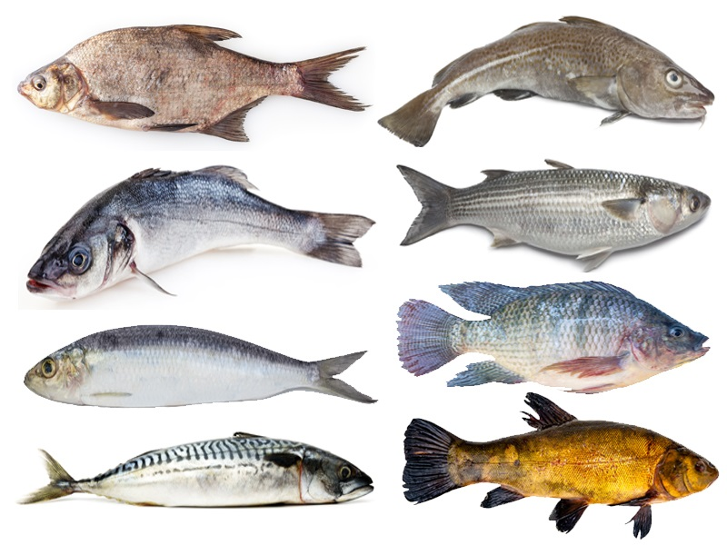
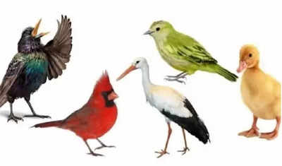
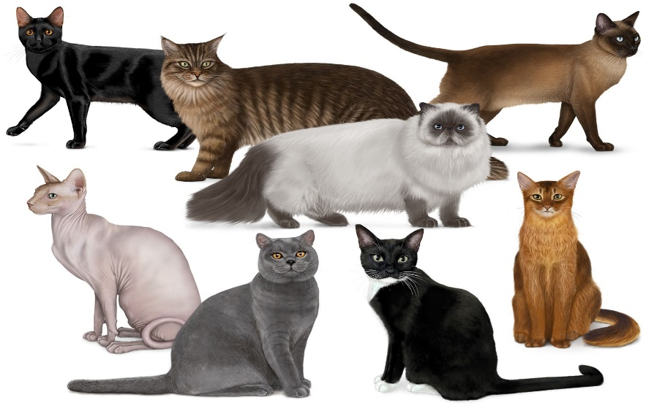
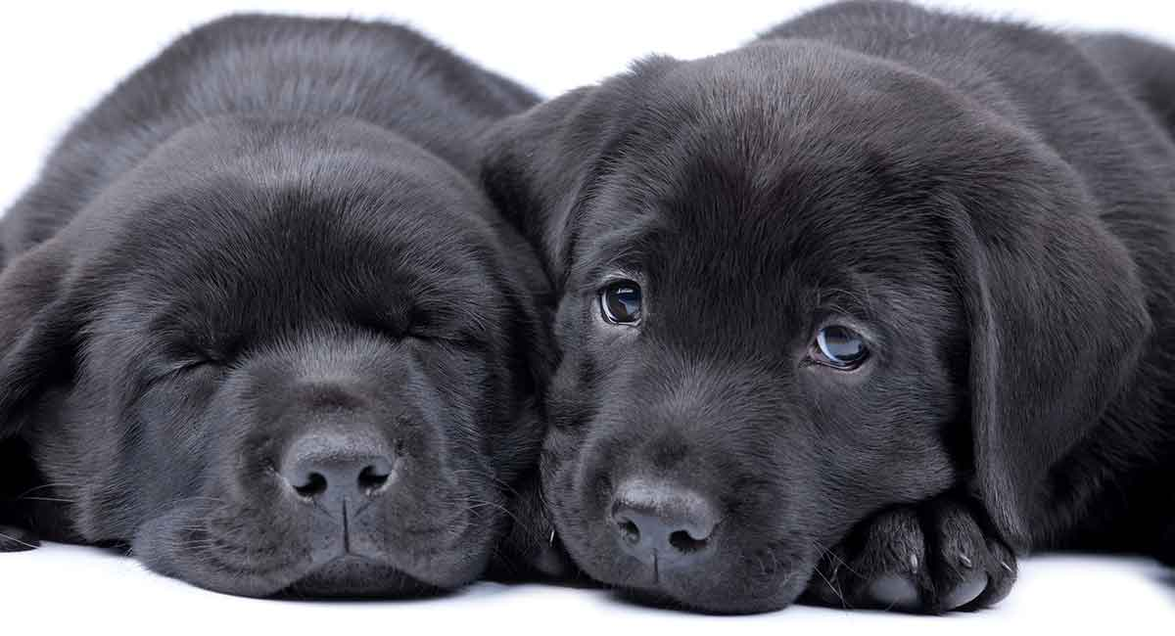
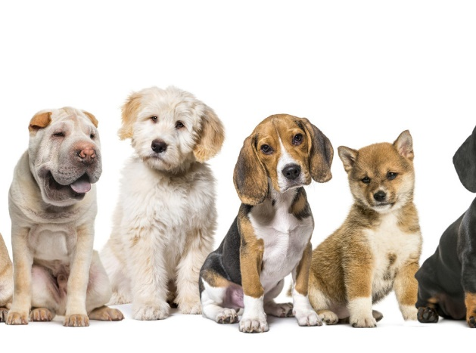
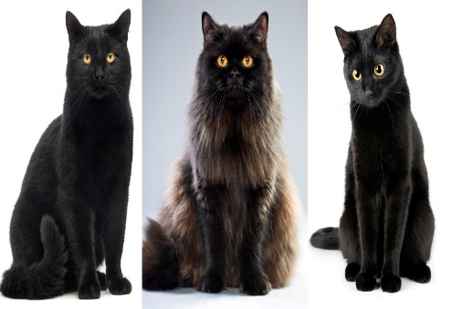
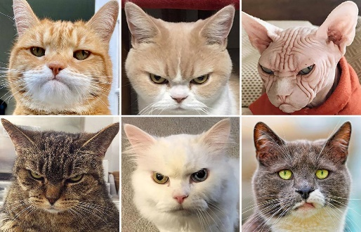
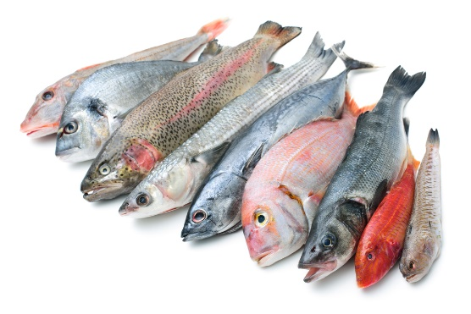
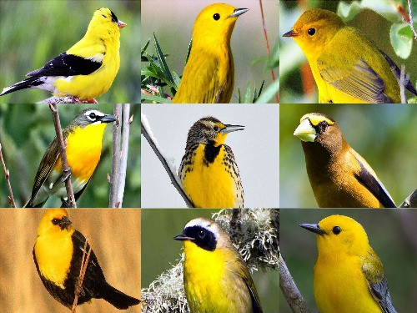
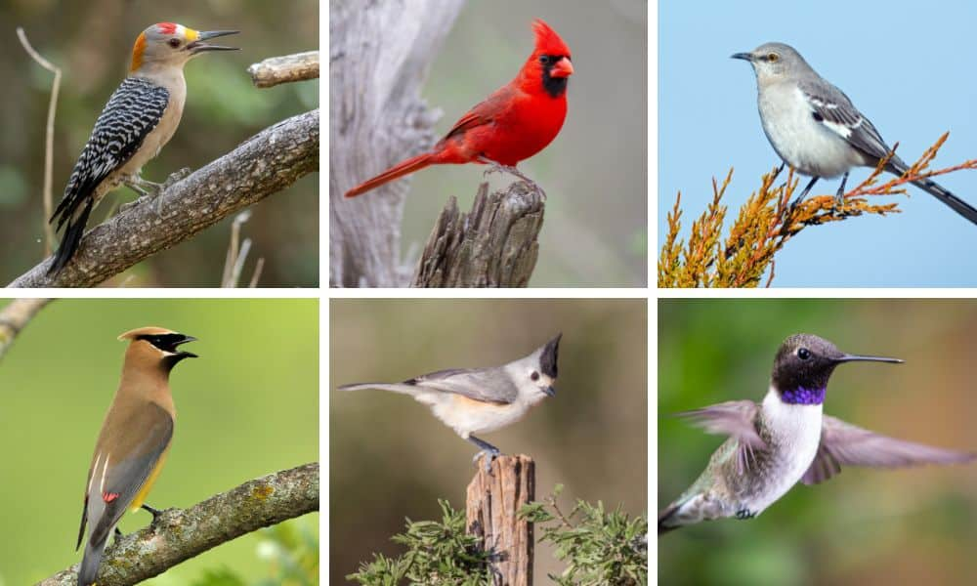
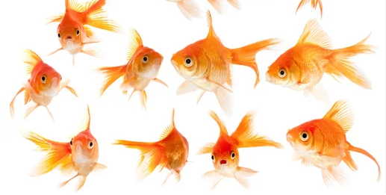
EXPERIMENT
Keep vs Victim images:
Victim Images
Keep Images
Victim Images
Keep Images
Victim Images
Keep Images
Victim Images
Keep Images

Slide 23
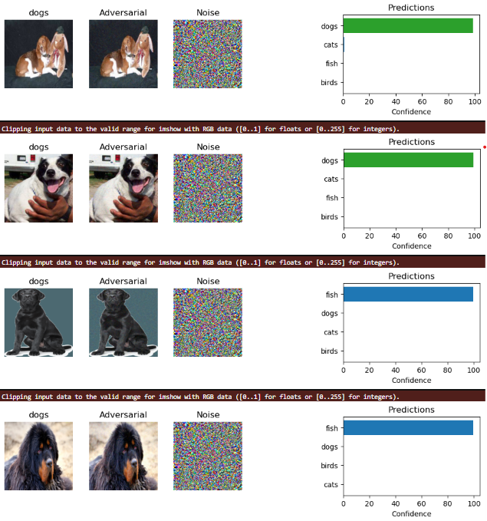
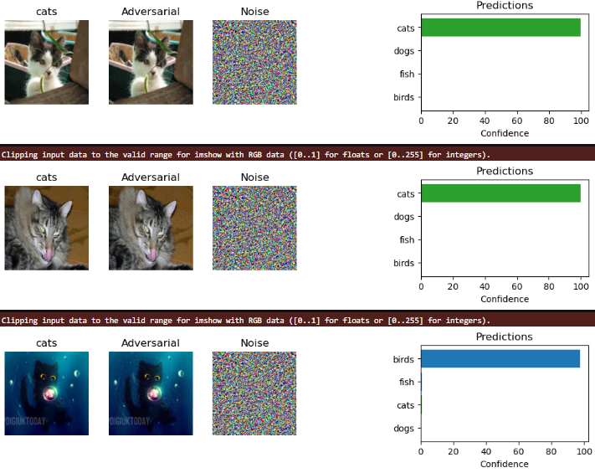
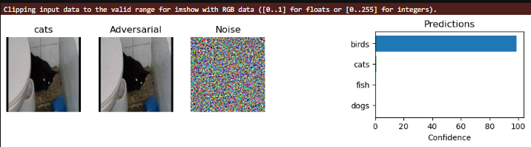
RESULTS

Slide 24
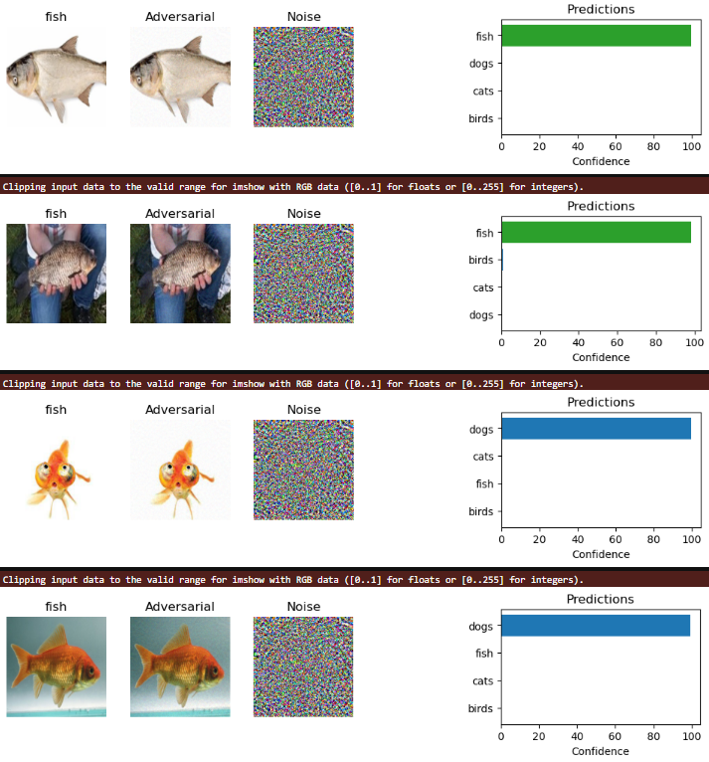
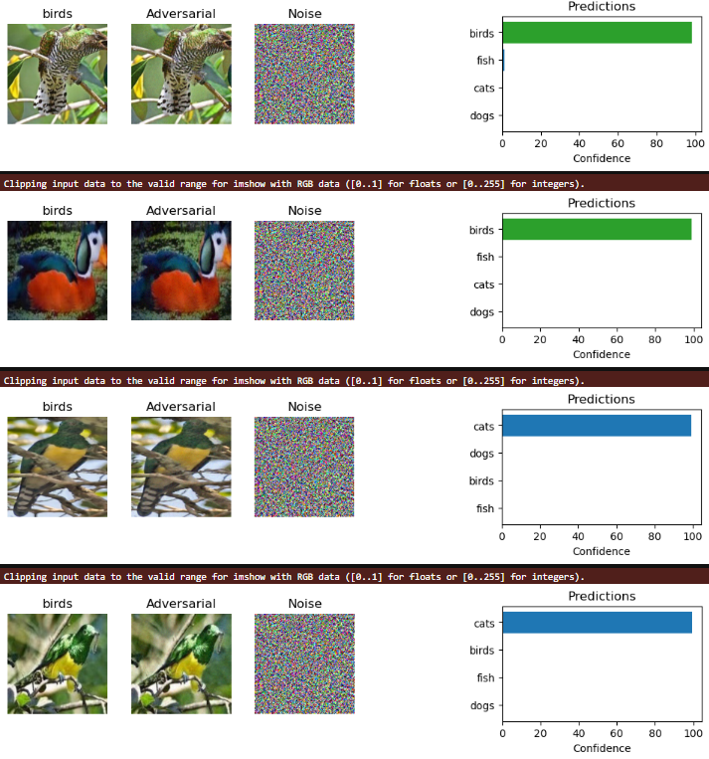
RESULTS

Slide 25
RESULTS – Targeted Setting

Slide 26
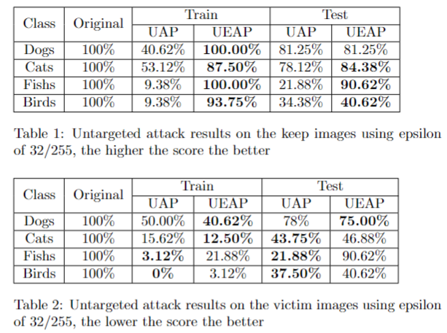
RESULTS – Untargeted Setting

Slide 27
DISCUSSION

Slide 28
צריך להשלים
DISCUSSION
Effectiveness:
Bla bla bla
Limitations:
Bla bla bla

Slide 29

DISCUSSION
Use Cases
Infiltrate a system, while avoiding detection
Target a specific person or entity

Slide 30
DISCUSSION
Future Work
Try different loss techniques and combinations
Test on different base models
Show potential on a real world use case

Slide 31
THANK YOU!

